Slide 1
Generating noisy speech data from clean data in the frequency domain using Deep Learning Methods
Week – 14
Name: Shashank Shirol
University: Manipal Institute of Technology
Duration of the presentation: ~10 mins.

Slide 2
Tasks to be completed:
Train CUT implementation with longer samples to determine by how bad the results are when longer samples are resized to 256x256.
Explore and assess viability of using different transforms instead of resizing (to maintain aspect ratio).
Try training CUT without resizing the samples (remove the resize transform module from the pre-processing pipeline) and assess the results.
Study solutions to deal with longer samples – because CUT resizes the spectrograms to a fixed size of 256x256
Use modified parameters for extracting spectrograms of longer samples.
Splitting input audio into shorter samples and then feeding to CUT.

Slide 3
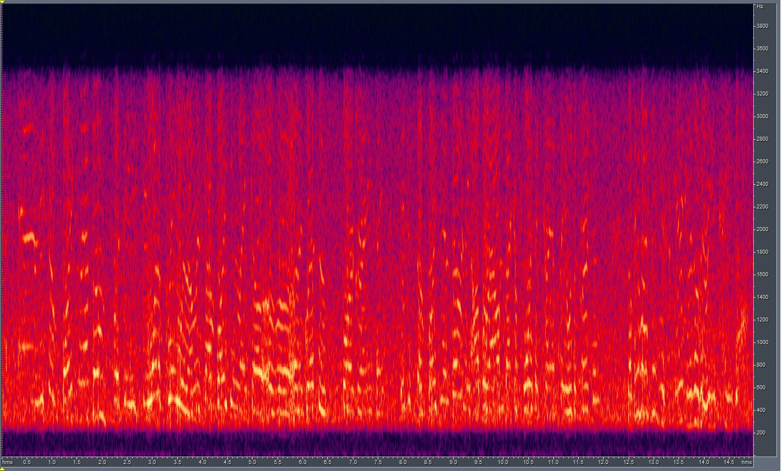
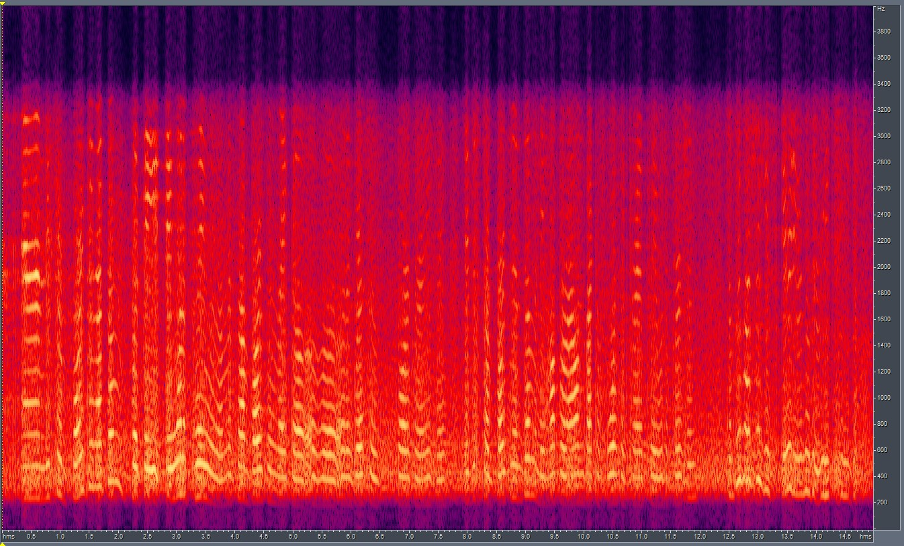

Training CUT with longer samples to determine the impact on performance:
To properly assess the impact of generation with long samples, we train the current implementation of CUT with longer samples (~14 secs instead of ~6 secs) from the RATS corpus.
As predicted, the LSD score takes a hit. LSD goes from a score of 6.05 (short samples) to 7.10 (long samples).
Results are as follows:
GT
OUTPUT

Slide 4
Assessing a viable alternative to the resizing transform – Cropping (I)
The CUT implementation, in its original implementation, used a variety of transforms like resize, width-scaling, zoom, random crop, etc.
We removed the excessive transforms and retained only resize transform in the lite-version of CUT. This effectively improved the performance of CUT when fed with spectrograms.
It is clear that, due to inefficiency and limitations of rescaling algorithms, this implementation would break for longer audio files.
We, therefore, explore CenterCrop – a torchVision transform that crops the image when it is passed through this transform.
This would, effectively solve the problem of training with longer samples as we would only crop and extract a small portion to learn the mapping.

Slide 5
Assessing a viable alternative to the resizing transform – Cropping (II)
Problems with this approach:
Since CUT is an image-to-image translation model, it uses images from both domains to learn the mapping (that too unpaired images).
So, this approach would fail if a sample from domain A has no speech activity in the cropped portion but the randomly chosen domain B sample crop has instances of speech.
The model would end up learning an incorrect mapping.
This also poses a problem during the generation process.
We cannot just generate fake output for the cropped portion, we need to apply the mapping to the entire spectrogram.
Partial Solution to the problems above:
We can use paired samples for training – so the corresponding crops are matched and mapping learned accordingly.
Note: The partial solution discussed here is a part of more viable solution discussed later.

Slide 6
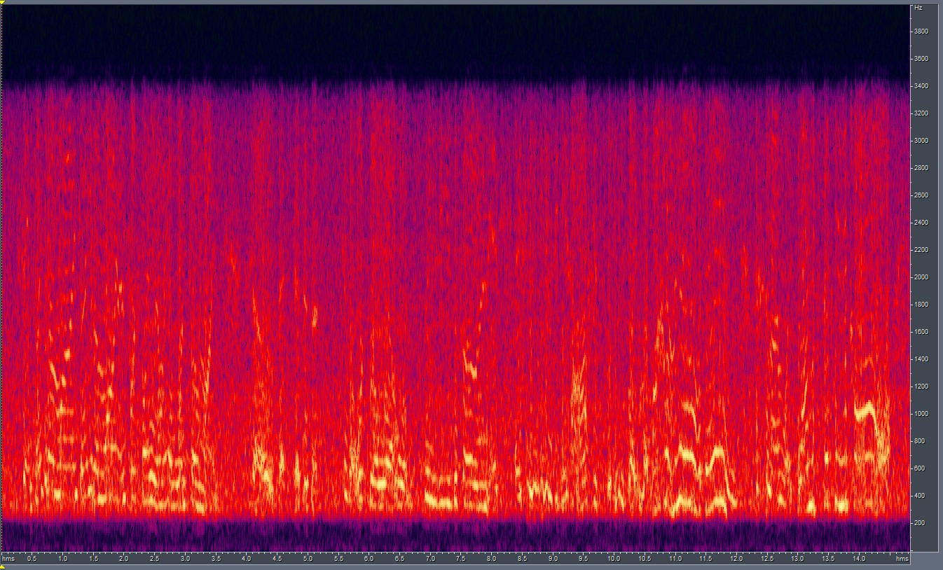
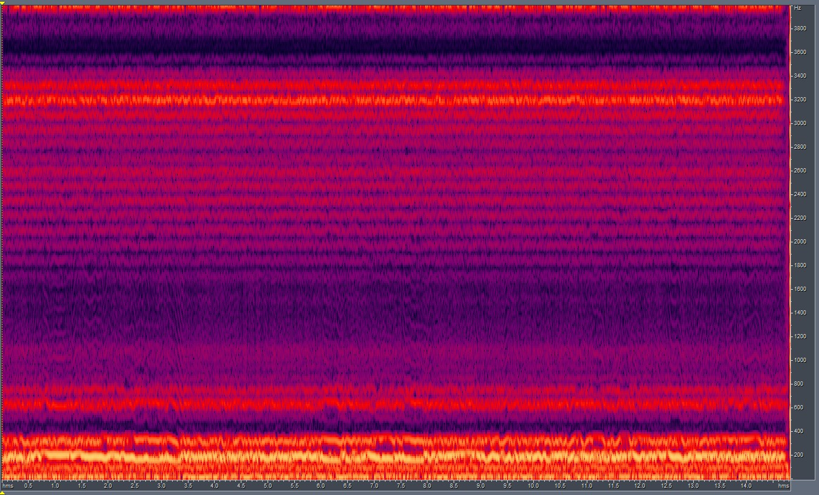
Training CUT without the resize transform:
Here, we trained CUT with long paired samples by bypassing the resize transform.
This led to varied spectrogram sizes for the training samples, and ultimately resulted in the model not converging properly.
The results generated were extremely poor, this leads to the conclusion that uniformity in the input training samples is important and the use of resize transform is unescapable.
Results:
GT
Output

Slide 7
Solutions to deal with longer samples: (I)
Modifying the parameters for spectrogram extraction of longer samples:
The size of the spectrogram depends on a set of parameters: no. of FFT bins, hop length, and window size. Hence, it can be altered if we modify these.
Thus, we can obtain a smaller spectrogram for even a longer sample.
We test the above approach in the following experimental setup:
Training: Unpaired RATS samples (~6 secs) Generation: Unpaired RATS samples (~14 secs)
Parameters used previously. (Normal) n_fft = 256, hop_length = 64, win_size = 256 (defaults)
Modified parameters that reduce spectrogram dimension. (Test) n_fft = 256, hop_length = 128, win_size = 256
The effect of these on the spectrogram size is documented in the next slide

Slide 8
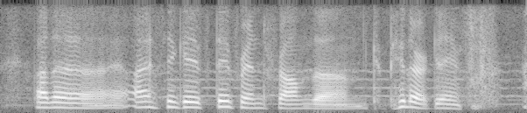
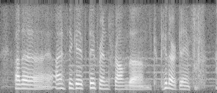
Modifying Spectrogram parameters (cont’d)
By modifying the parameters, we can go from (A) to (B).
(129, 602)
(A); hop_length = 64
(129, 301)
(B); hop_length = 128

Slide 9
Modifying Spectrogram parameters (cont’d)
But, by making the spectrogram shorter you are increasing the number of audio samples between adjacent STFT columns. This is evident from the fact that if we reconstruct the audio, a 14-sec audio is now 7-sec audio (for previous example)
To tackle this, we look at it from a CV point of view. i.e. after generation using the shorter spectrogram, we resize the output to the normal spectrogram dimensions and use the normal phase for reconstruction.
The results and the LSDs for each are documented in the next slide.

Slide 10
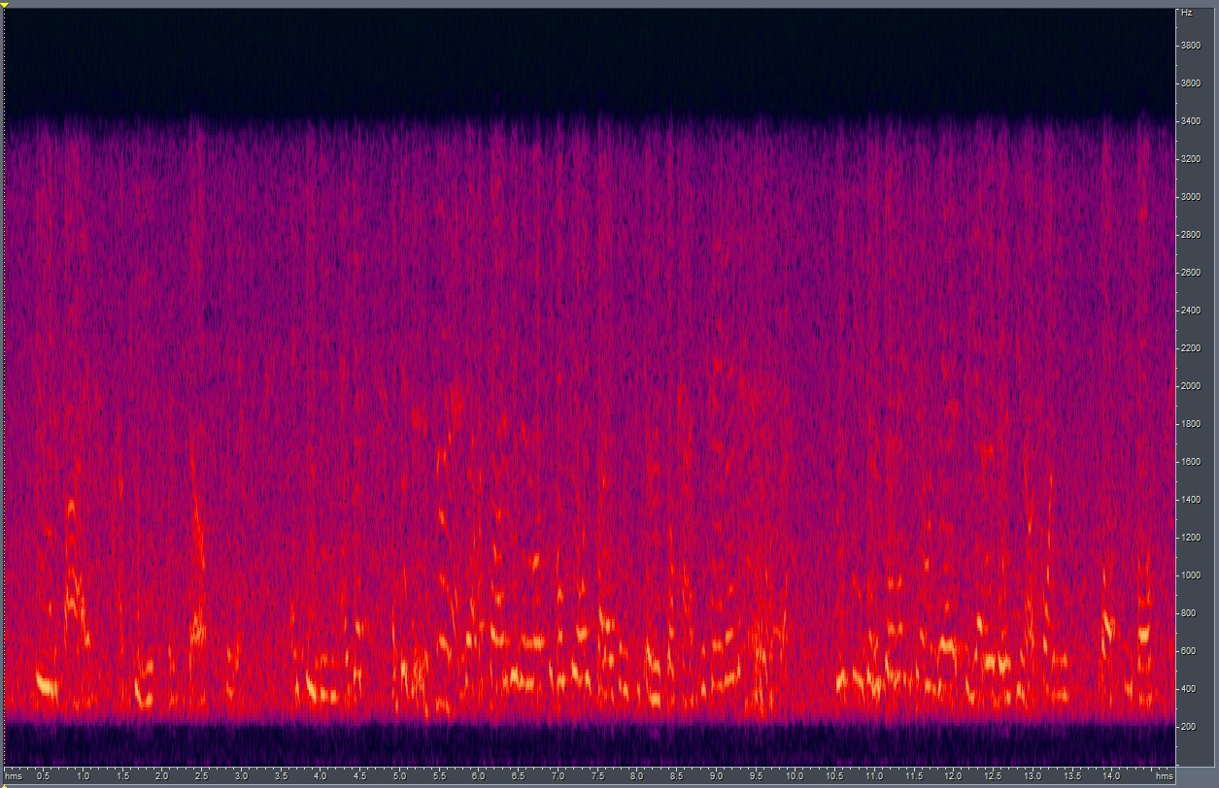
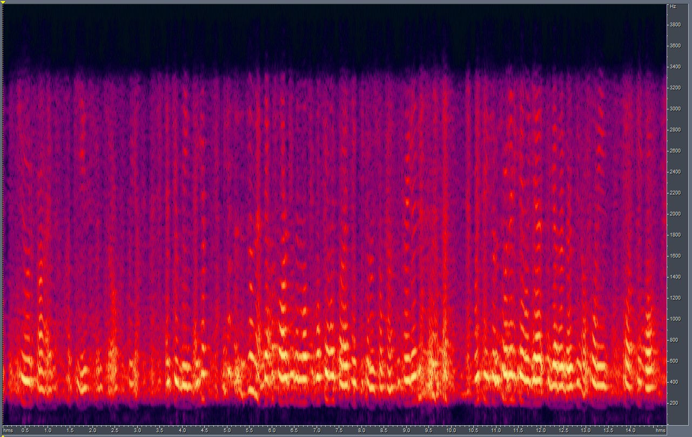
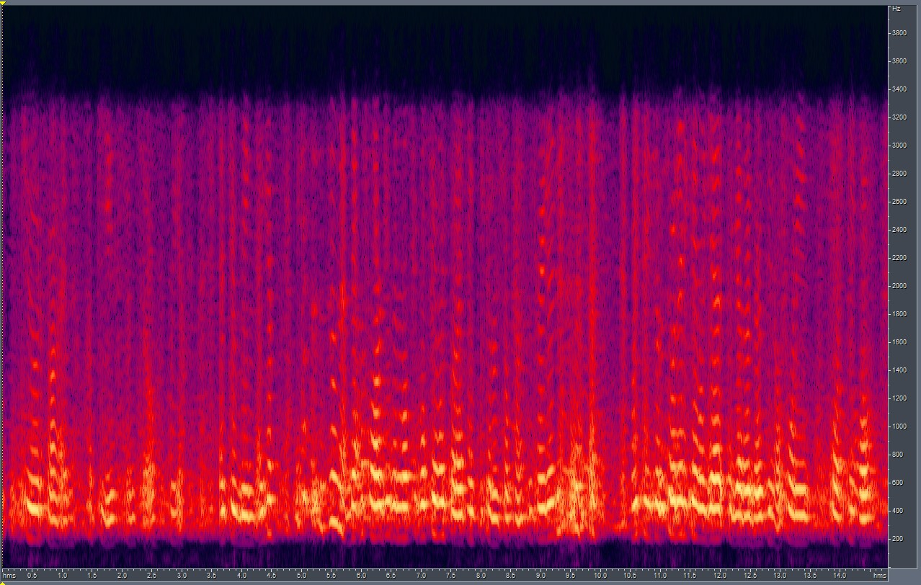
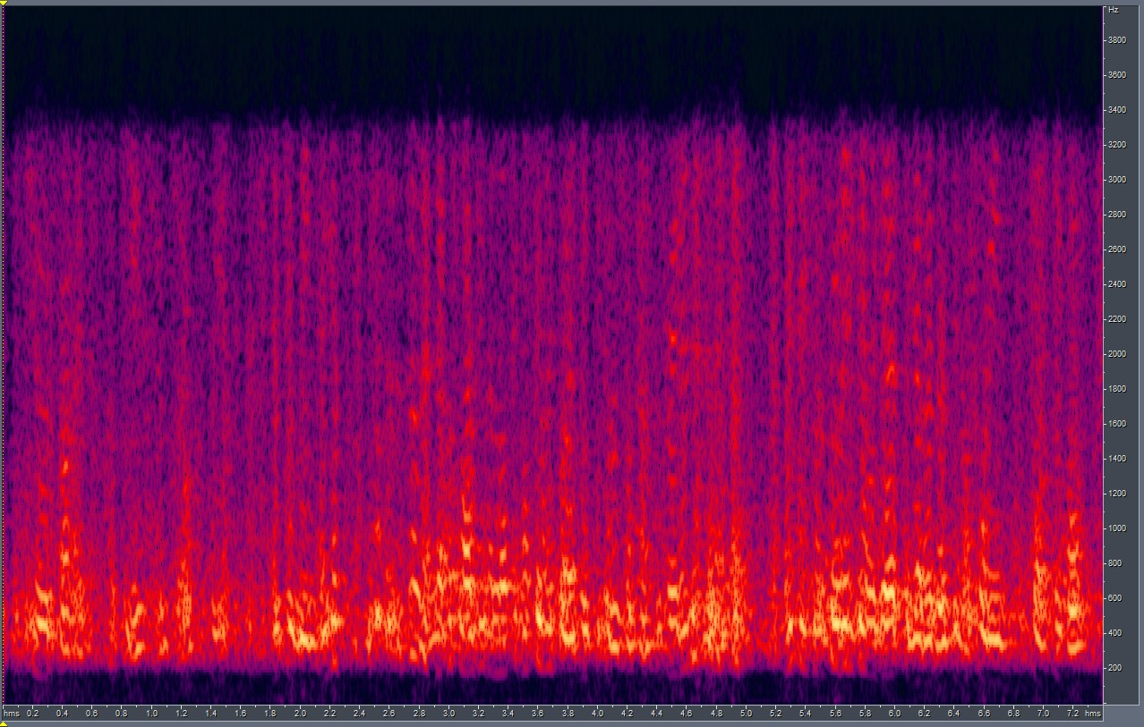
Modifying Spectrogram parameters (cont’d)
LSD = 6.650
GT
Test setup – Custom Generation
LSD = 6.659
LSD = 11.478
Normal setup
Test setup – Lossy Generation

Slide 11
Solutions to deal with longer samples: (II)
Splitting the waveforms into smaller waveforms and training with their spectrograms.
Problems to tackle with this approach:
Keeping track of the order of the split waveform components.
Stitching the output spectrograms to obtain the resultant, complete, spectrogram for reconstruction.
The performance overhead involved in dealing with splitting and stitching during training/generation.
A modified approach that works:
Instead of splitting the waveforms, apply the split on the spectrogram of the full sample. It is easier to keep track and restitch a spectrogram than to restitch a waveform (since the dims are whole numbers).
This alleviates the need to treat long samples separately, and we get to retain the original model – we train the model as before, but for generation, we break a large spectrogram of a sample into smaller components and treat them as individual samples.
Smaller spectrograms (say, for 4 secs sample) perform well even when resized (evident from previous weeks’ experiments)
And, since the generation process in CUT is sequential, this lifts the overhead of keeping track of order of components.

Slide 12
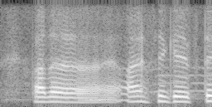
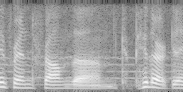
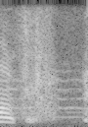
Modules for splitting and stitching:
Wrote python modules to facilitate splitting and stitching spectrograms.
Results are as follows:
Original File
Audio Reconstructed after stitching components together.
Comp 1
Comp 2
Comp 3

Slide 13
End.

